Slide 1
Computer Organization and Assembly Language (COAL)

Slide 2
Lecture Objectives
Basic Processing Unit (Hamacher Ch # 5)
Fetch & Execute Cycle
Data Processing Hardware
Instruction Execution (LOAD, ADD, STORE)
5 Step Fetch and Execution Implementation
Register File
ALU
Five Stage Organization
DATAPATH in a processor
Instruction Fetch and Execute Section

Slide 3
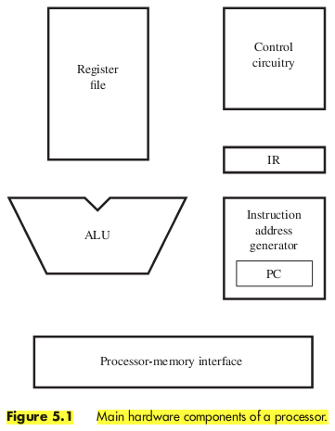
Fetch & Execute Cycle
Instruction Fetch Phase
Instruction Execute Phase
Read page 152 and 153

Slide 4
The processor fetches one instruction at a time and performs the operation specified.
Instructions are fetched from successive memory locations until a branch or a jump instruction is encountered.
The processor uses the program counter, PC, to keep track of the address of the next instruction to be fetched and executed.
After fetching an instruction, the contents of the PC are updated to point to the next instruction in sequence.
A branch instruction may cause a different value to be loaded into the PC.

Slide 5
When an instruction is fetched, it is placed in the instruction register, IR, from where it is interpreted, or decoded, by the processor’s control circuitry.
The IR holds the instruction until its execution is completed.
Consider a 32-bit computer in which each instruction is contained in one word in the memory.
To execute an instruction, the processor has to perform the following steps:
1. Fetch the contents of the memory location pointed to by the PC. The contents of this location are the instruction to be executed; hence they are loaded into the IR. IR←[[PC]]
2. Increment the PC to point to the next instruction. Assuming that the memory is byte addressable, the PC is incremented by 4; that is
PC←[PC] + 4
3. Carry out the operation specified by the instruction in the IR.
Fetching an instruction and loading it into the IR is usually referred to as the instruction fetch phase.
Performing the operation specified in the instruction constitutes the instruction execution phase.

Slide 6
The processor communicates with the memory through the processor-memory interface, which transfers data from and to the memory during Read and Write operations.
The instruction address generator updates the contents of the PC after every instruction is fetched.
The register file is a memory unit whose storage locations are organized to form the processor’s general-purpose registers.
During execution, the contents of the registers that performs an arithmetic or logic operation are sent to the arithmetic and logic unit (ALU), which performs the required computation.
The results of the computation are stored in a register in the register file.

Slide 7
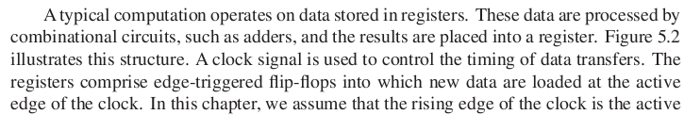
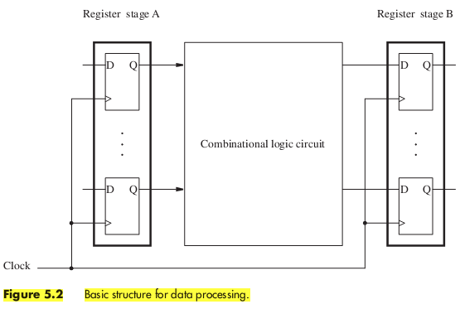
Data Processing Hardware (1)

Slide 8
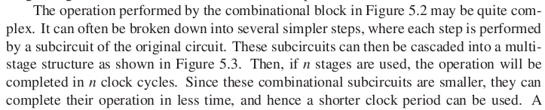
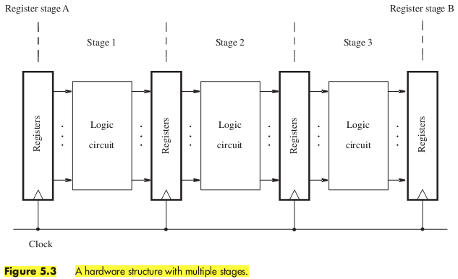
Data Processing Hardware (2)

Slide 9
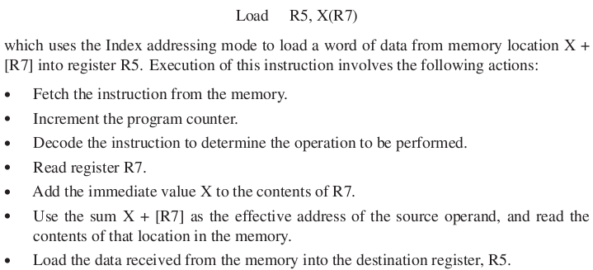
Load Instructions (1)

Slide 10
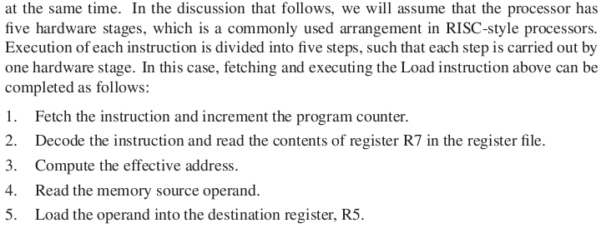
Load Instructions (2)

Slide 11
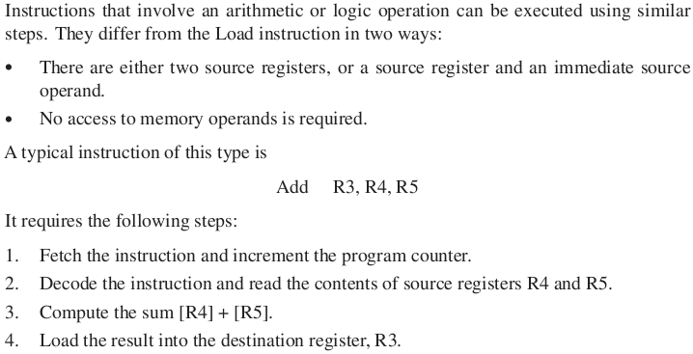

Arithmetic & Logic Instructions (1)
In order to keep 5 stage processing

Slide 12
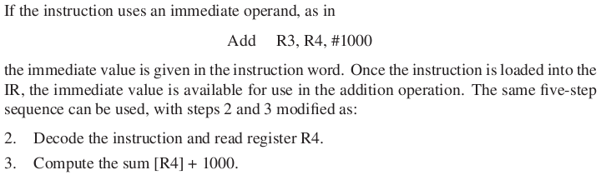
Arithmetic & Logic Instructions (2)

Slide 13
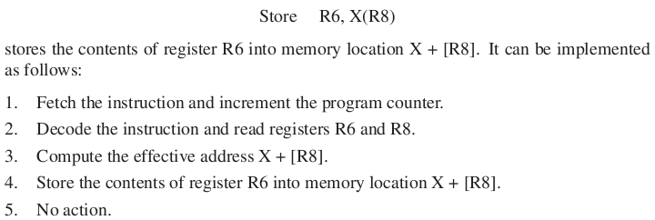
Store Instructions (1)

Slide 14
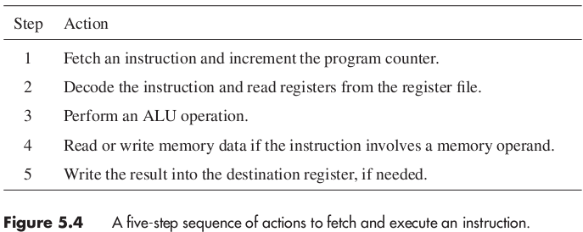
5 Step suitable for all RISC Instructions

Slide 15
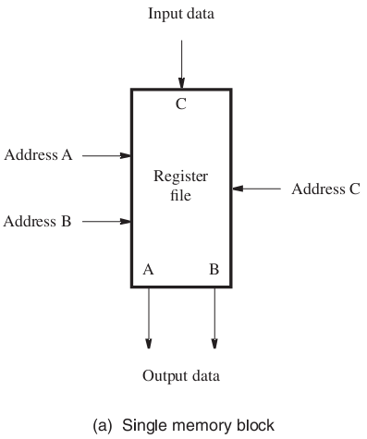
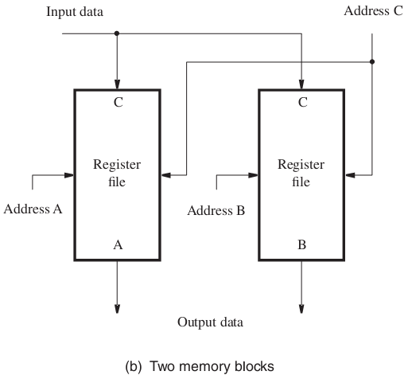
Register File

Slide 16
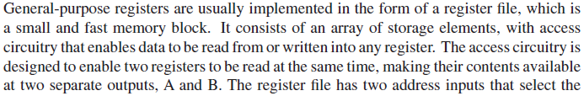
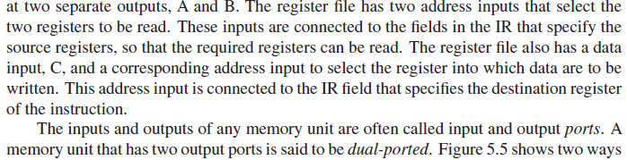
Register File

Slide 17
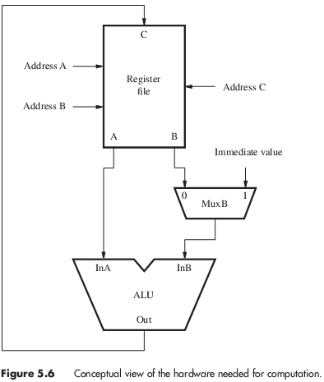
ALU

Slide 18
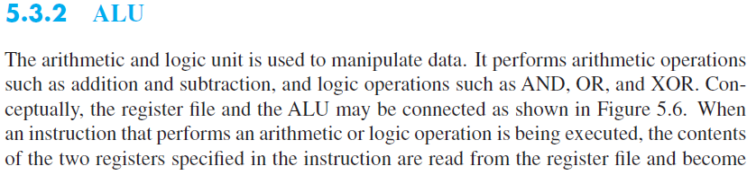
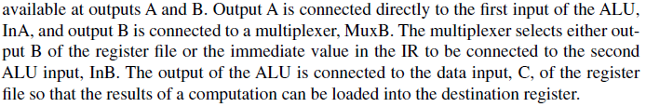

Slide 19
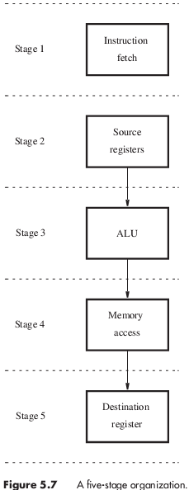
5 Stage Organization
P 1
P 2

Slide 20
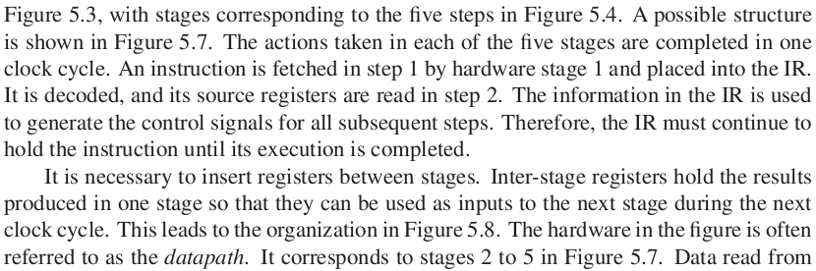
How to connect Register File and ALU together in 5 stages?
Each stage’s action completes in one clock cycle
Inter-stage registers to hold temporal results

Slide 21
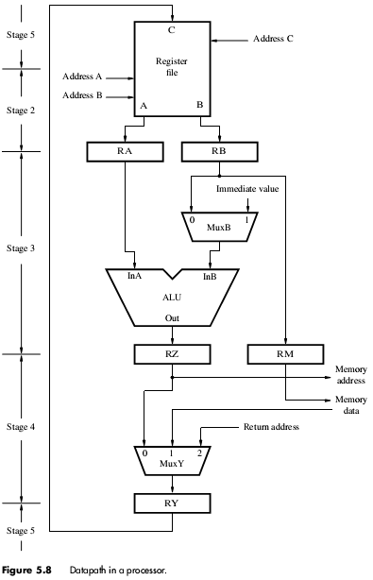

Slide 22
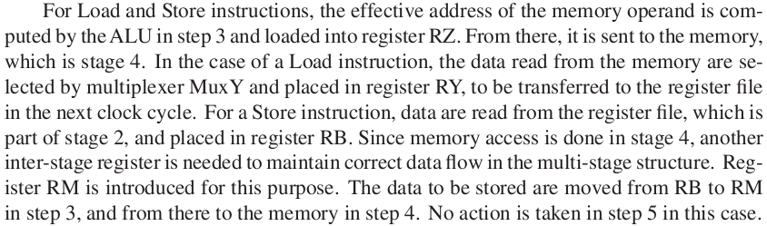
DATAPATH Details
No processing in Step 4 for arithmetic & logic Instructions
Register File in both Stage 2 and 5
Load R1, #3424H
Store #3424H, R1
Return Address in case of CALL and/or Interrupt need to be saved in LINK/IRA general purpose register

Slide 23
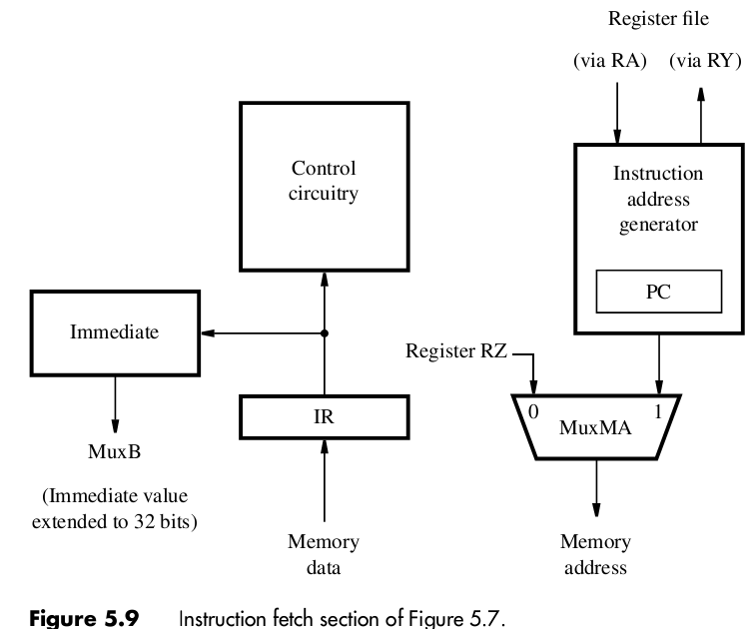

Slide 24
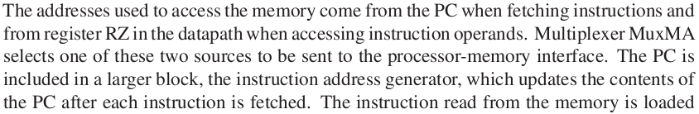
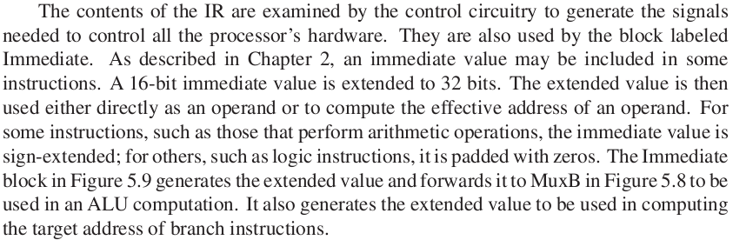
Instruction Fetch Section (1)

Slide 25
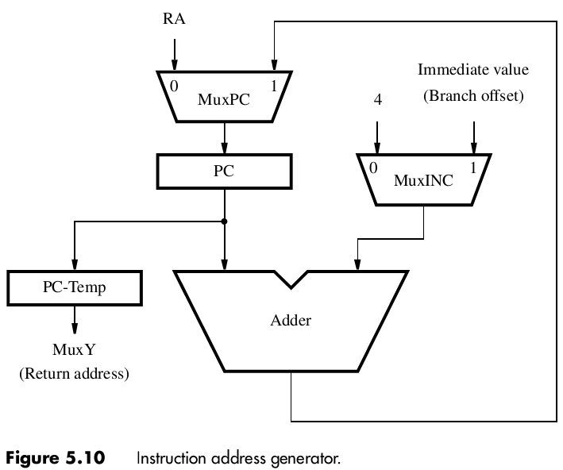

Slide 26
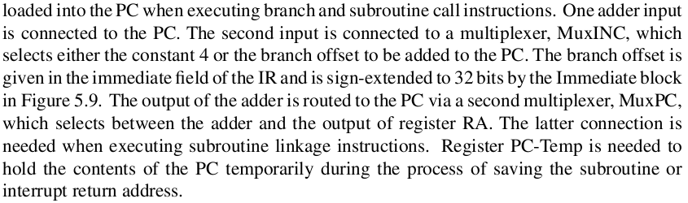

Slide 27
Lecture Objectives
Basic Processing Unit (Hamacher Ch # 5)
DATAPATH quick review
Instruction Fetch and Execute Section
Instruction address generator
Instruction Encoding
Instruction Fetch and Execute Steps
Add, Load, Store
Unconditional and Conditional branches
Call instructions

Slide 30
Instruction Fetch Section (1)
PC is part of Instruction Address generator
Addresses for Memory access come from:
Program Counter (PC) when fetching instruction
Inter-stage Register (RZ) when accessing instructions operand
Based on the instruction in IR, Multiplexer MuxMA selects one of the two sources (PC or RZ) and send it to the processor-memory interface.
Contents of IR are examined by the control circuitry to generate the signals needed to control all the processor’s hardware.

Slide 31
Instruction Fetch Section (2)
Immediate values embedded in instructions are extended to 32 bits and used as:
Operand
Effective address of operand
When necessary immediate value is either sign extended (for arithmetic operation) or padded with zeros (logic instructions).
Immediate value are forwarded to multiplexer MuxB of DATAPATH for ALU processing if needed.

Slide 33
Instruction Fetch Section (3)
PC is incremented by 4 during straight-line execution.
Immediate value is used to compute address of the next instruction in case of Branch/Jump or Call instruction.
MuxINC selects value for straight-line execution or branch/call address.
MuxPC selects address coming from incremented yyyyyy/ calculated value or call register value in RA.
PC-Temp is used to store old PC value as return address during a Call or Interrupt. PC-Temp is forwarded to MuxY.

Slide 34
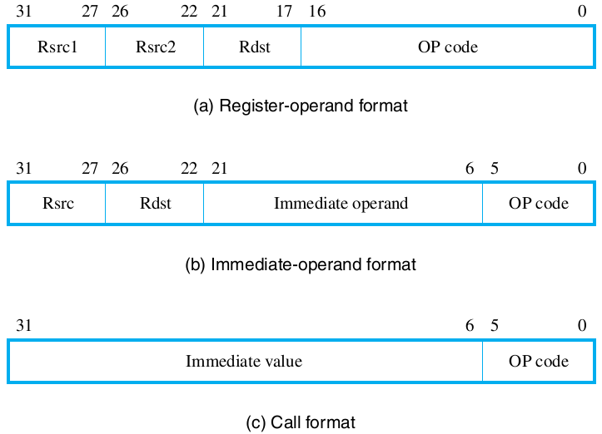
Instruction Encoding

Slide 35
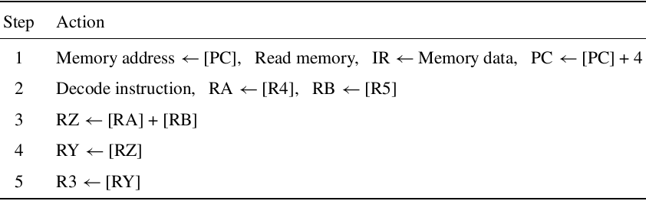
Instruction Fetch & Execution Steps

Slide 37
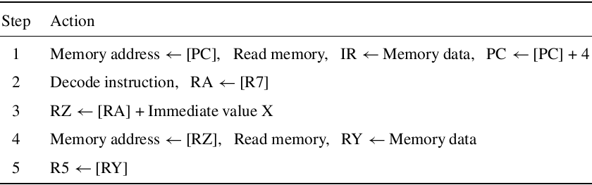
Instruction Fetch & Execution Steps

Slide 38
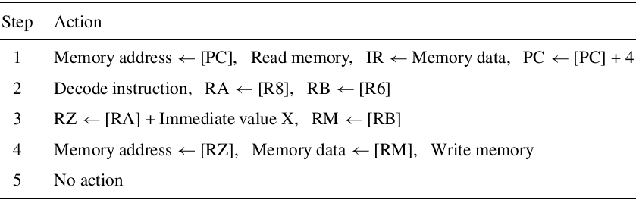
Instruction Fetch & Execution Steps

Slide 39
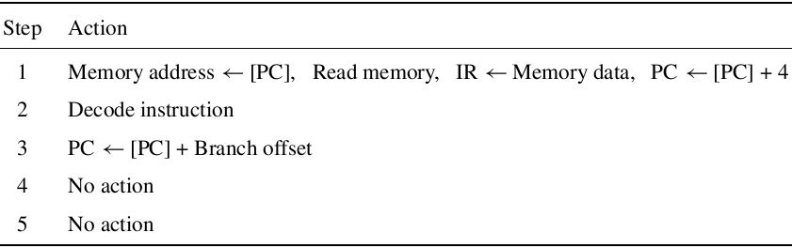
Instruction Fetch & Execution Steps

Slide 40
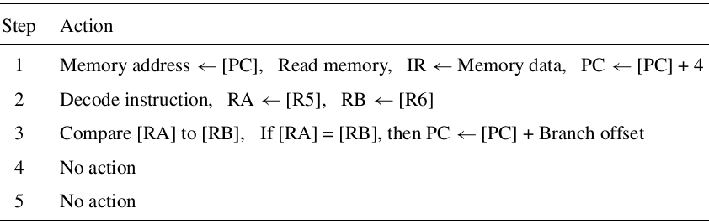
Instruction Fetch & Execution Steps

Slide 41
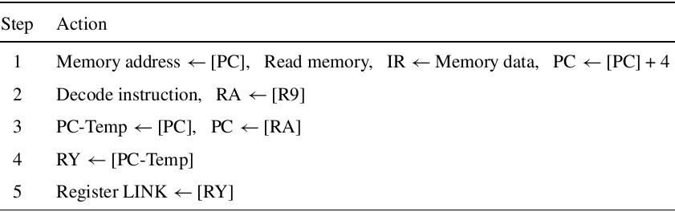
Instruction Fetch & Execution Steps

Slide 42
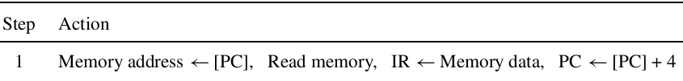

Waiting for Memory

Slide 43
Lecture Objectives
Basic Processing Unit (Hamacher Ch # 5)
Control Signals
Control Signals for the DATAPATH
Hardwired Control
DATAPATH Control Signals
Dealing with memory delays
CISC Style Processors
Interconnect using Busses
Microprogrammed Control

Slide 44

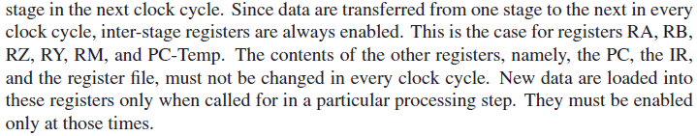
Control Signals

Slide 45
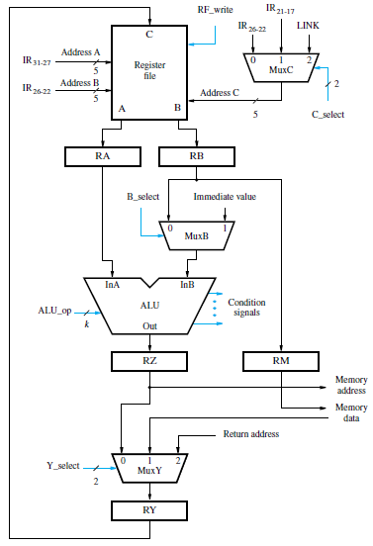

Slide 47
Instruction Encoding

Slide 48
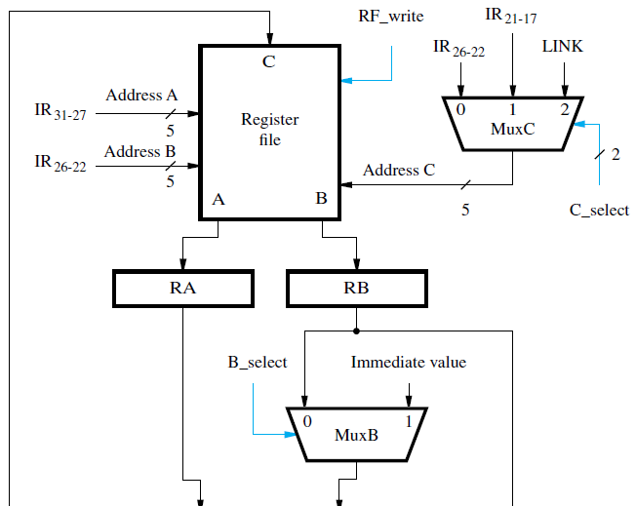
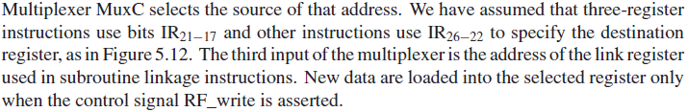

Slide 49
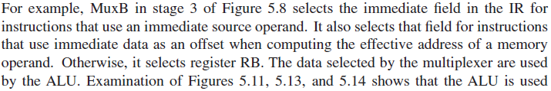
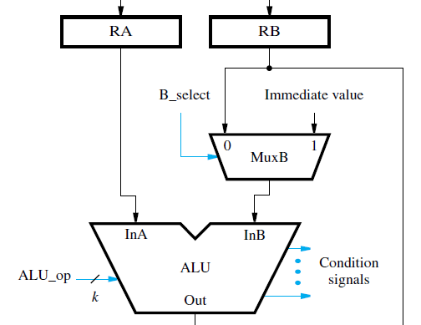

Slide 50
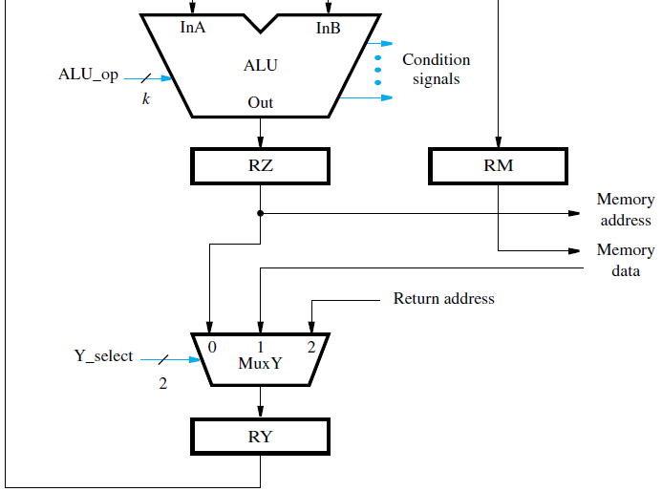
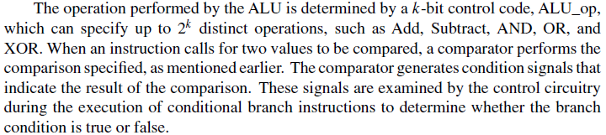

Slide 51
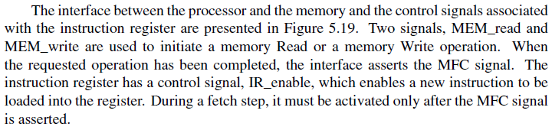
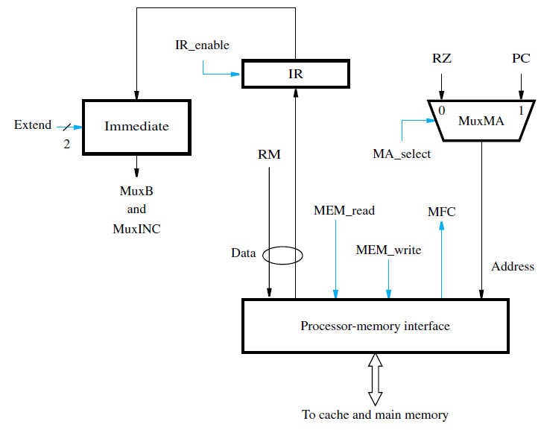

Slide 52
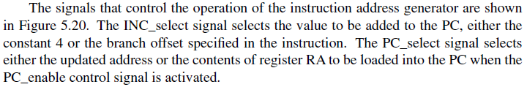
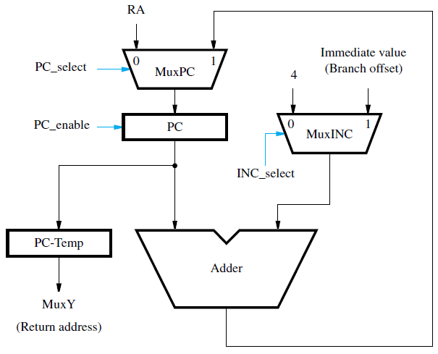

Slide 53
Hardwired Control

Slide 54
How Control Signals are generated?
How the processor generates the control signals that cause these actions to take place in the correct sequence and at the right time?
There are two basic approaches:
Hardwired control &
Micro-programmed control

Slide 55
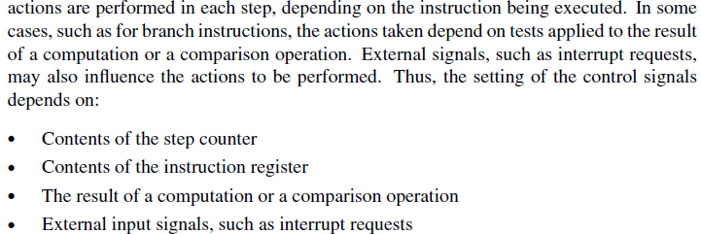
Hardwired Control (1)

Slide 56
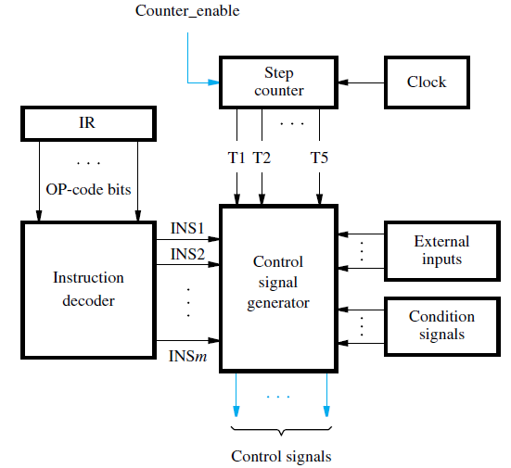
Hardwired Control (2)

Slide 57
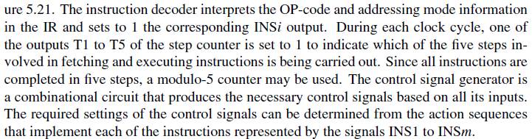
Hardwired Control (3)

Slide 58

Hardwired Control (4)

Slide 59


DATAPATH Control Signals (1)

Slide 60



DATAPATH Control Signals (2)

Slide 61

Handling Memory Delay (1)

Slide 62

Handling Memory Delay (2)

Slide 63

CISC Processor Organization

Slide 64
Micro-programmed Control (1)
Micro-programmed control was an interesting and popular alternative in the past.
Control signals are generated for each execution step based on the instruction in the IR. In hardwired control, these signals are generated by circuits that interpret the contents of the IR as well as the timing signals derived from a step counter.
In micro-programmed control, instead of employing such circuits, it is possible to use a “software" approach, in which the desired setting of the control signals in each step is determined by a program stored in a special memory.

Slide 65
Micro-programmed Control (2)
The control program is called a micro-program to distinguish it from the program being executed by the processor. The micro-program is stored on the processor chip in a small and fast memory called the micro-program memory or the control store.
Suppose that n control signals are needed. Let each control signal be represented by a bit in an n-bit word, which is often referred to as a control word or a microinstruction.

Slide 66
Micro-programmed Control (4)
In a instruction words, each bit specifies the setting of the corresponding signal for a particular step in the execution flow.
One control word is stored in the micro-program memory for each step in the execution sequence of an instruction.
For example, the action of reading an instruction or a data operand from the memory requires use of the MEM_read and WMFC signals introduced in Sections 5.5 and 5.6.2, respectively. These signals are asserted by setting the corresponding bits in the control word to 1 for steps 1, 3, and 5 in Figure 5.26.
When a microinstruction is read from the control store, each control signal takes on the value of its corresponding bit.

Slide 67
Micro-programmed Control (5)
The sequence of microinstructions corresponding to a given machine instruction constitutes the micro-routine that implements that instruction.
The first two steps in Figures 5.25 and 5.26 specify the actions for fetching and decoding an instruction. They are common to all instructions. The micro-routine that is specific to a given machine instruction starts with step 3.

Slide 68
Micro-programmed Control (6)
The microinstruction address generator decodes the instruction in the IR to obtain the starting address of the corresponding microroutine and loads that address into the μPC. This is the address that will be used in the following clock cycle to read the control word corresponding to step 3.
As execution proceeds, the microinstruction address generator increments the μPC to read microinstructions from successive locations in the control store. One bit in the microinstruction, which we will call End, is used to mark the last microinstruction in a given microroutine. When End is equal to 1, as would be the case in step 3 in Figure 5.25 and step 7 in Figure 5.26, the address generator returns to the microinstruction corresponding to step 1, which causes a new machine instruction to be fetched.

Slide 69
Micro-programmed Control (7)
Micro-programmed control is simple to implement and provides considerable flexibility in controlling the execution of machine instructions. But, it is slower than hardwired control.
The flexibility it provides is not needed in RISC-style processors as the control signals needed to implement RISC-style instructions are quite simple to generate.
Since the cost of logic circuitry is no longer a significant factor, hardwired control has become the preferred choice.

Slide 70
CISC-Style Processors
Unlike RISC-style instruction sets, where only Load and Store instructions access data in the memory, CISC instructions can operate directly on memory operands.
Also, they are not restricted to one word in length. An instruction may use several words to specify operand addresses and the actions to be performed.
The main difference between this organization and the five-stage structure is that the Interconnect block, which provides interconnections among other blocks, does not prescribe any particular structure or pattern of data flow.
It provides paths that make it possible to transfer data between any two components, as needed to implement instructions.

Slide 71
In CISC, some registers are needed to hold intermediate results during instruction execution.
The temporary registers block in the figure is provided for this purpose. It includes two temporary registers, Temp1 and Temp2.
Buses are used in the implementation of the Interconnect.
A bus consists of a set of lines to which several devices may be connected, enabling data to be transferred from any one device to any other.
A logic gate that sends a signal over a bus line is called a bus driver.
Since all devices connected to the bus have the ability to send data, and it must been insured that only one of them is driving the bus at any given time.
For this reason, the bus driver is a special type of logic gate called a tri-state gate.
It has a control input that turns it on or off.
When turned on, the gate places a logic signal of 0 or 1 on the bus, according to the value of its input.
When turned off, the gate is electrically disconnected from the bus.

Slide 72

Figure 5.23 shows how a flip-flop that forms one bit of a data register can be connected to a bus line.
There are two control signals, Rin and Rout . When Rin is equal to 1 the multiplexer selects the data on the bus line to be loaded into the flip-flop.
Setting Rin to 0 causes the flip-flop to maintain its present value.
The output of the flip-flop is connected to the bus line through a tri-state gate, which is turned on when Rout is asserted.
At other times, the tri-state gate is turned off, allowing other components to drive the bus line.

Slide 73


Slide 74

CISC Execution

Slide 75

CISC Execution

Slide 76

Microprogrammed Control

Slide 77
Thank You

